Slide 1

6th Grade Accelerated Math
Unit 4, Lesson 6 Solving Problems Involving Rectangles on the Coordinate Plane Volume 1, pg. 165

Slide 2


Benchmarks
MA.6.GR.1.2
Find distances between ordered pairs, limited
to the same 𝑥-coordinate or the same
𝑦-coordinate, represented on the coordinate
plane.
MA.6.GR.1.3
Solve mathematical and real-world problems
by plotting points on a coordinate plane,
including finding the perimeter or area of a
rectangle.
volume 1, pg. 165

Slide 3

Learning Target
I can find distances between ordered pairs.
I can find the area of a rectangle on a coordinate plane.
I can find the fourth vertex of a rectangle on a coordinate plane.
volume 1, pg. 165

Slide 4

Warm-Up
volume 1, pg. 166

Slide 5

4.6.1 Warm-Up: True Statement
1. Place a digit in each blue box to make the statement true. Use only digits 1 to 9, at most one time each.
volume 1, pg. 166

Slide 6

Collaboration
volume 1, pg. 166

Slide 7

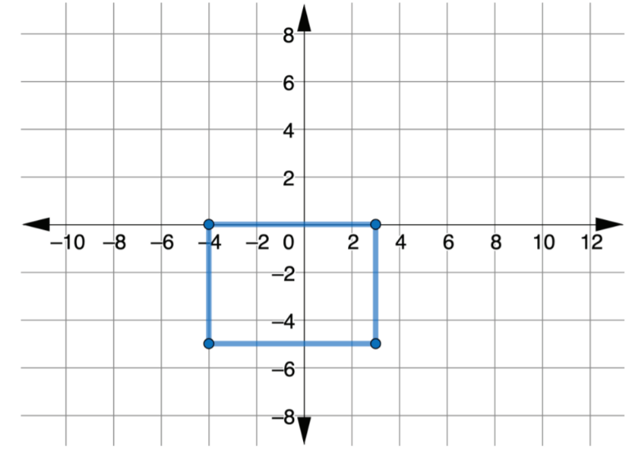
4.6.2 Collaboration: Area of Rectangles
Work with your partner to explain how to find the area of a rectangle.
A rectangle with coordinate (3, 0), (3, −5), (−4, 0), and (−4, −5) is shown. The scale of the grid is in centimeters (cm).
volume 1, pg. 166

Slide 8
Work with your partner to answer the following
questions.
a. Determine the length and the width of the rectangle.
Include units.
b. What is the area of the rectangle? Include units.
volume 1, pg. 166

Slide 9

Guided Practice
volume 1, pg. 167

Slide 10

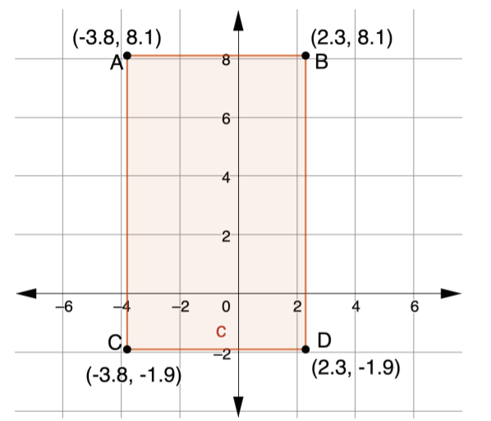
4.6.3 Guided Practice: Finding the Area of Rectangles on the Coordinate Plane
Henry wants to install new carpet in his living room. A drawing of his living room, with measurements in
feet, is shown.
What is the area of
the living room?
volume 1, pg. 167

Slide 11
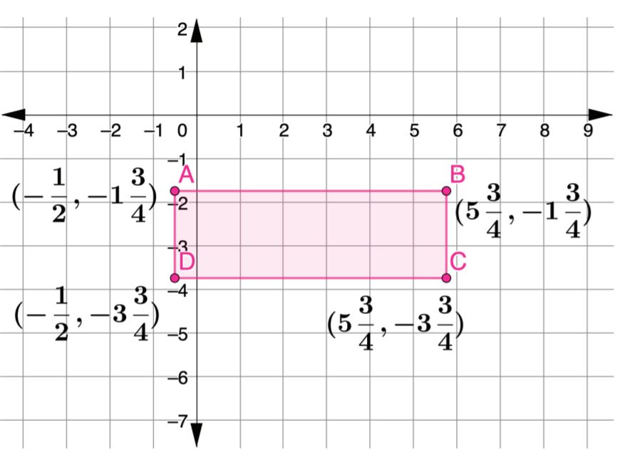
2. A rectangle is shown.
What is the area of the rectangle?
volume 1, pg. 167

Slide 12
Collaboration
volume 1, pg. 168

Slide 13
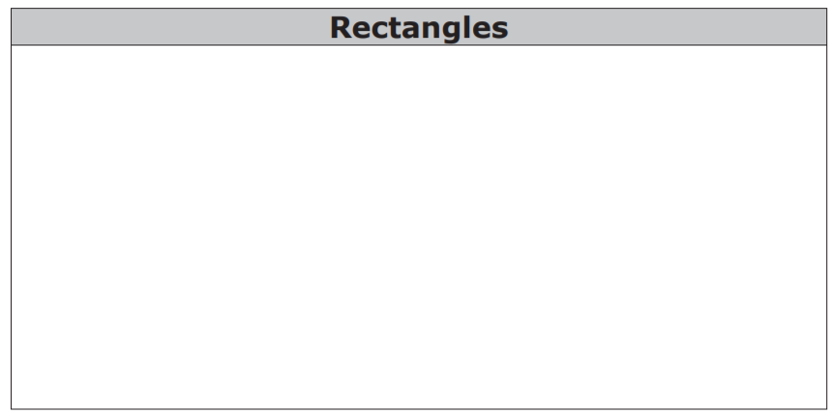
4.6.4 Collaboration: Finding the Fourth Vertex
With your partner, list every attribute you know about rectangles.
2. With your partner, find another pair of partners. Share what you wrote about rectangles. Add any new attributes the other group found that you didn’t.
volume 1, pg. 168

Slide 14
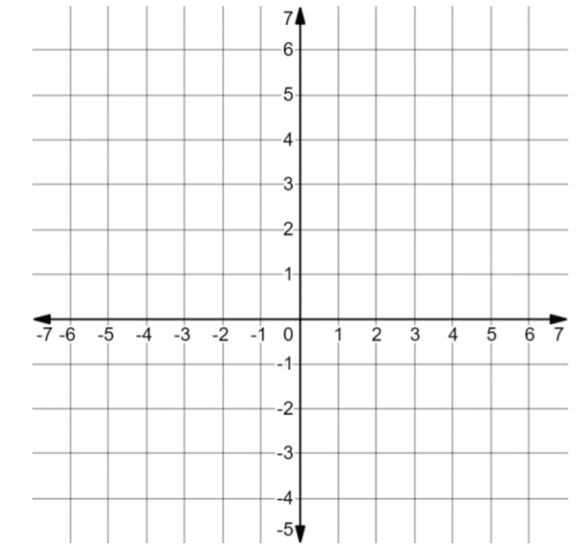
3. On the coordinate grid, draw a rectangle whose sides lie on the gridlines. Label the ordered pair of each vertex.
4. Discuss with your partner how to determine where to place the vertices of your rectangle. Write a summary of your discussion.
5. Based on the rectangle drawn in the previous questions, add any attributes about rectangles to your list.
volume 1, pg. 168

Slide 15
Guided Practice
volume 1, pg. 169

Slide 16
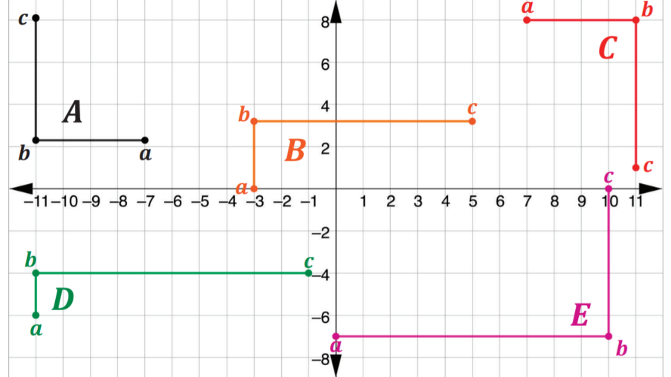
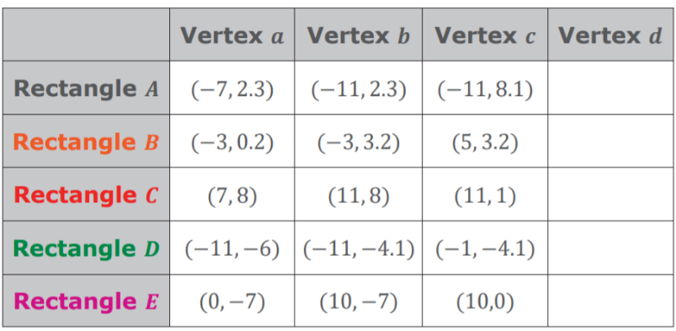
4.6.5 Guided Practice: Finding the Fourth Vertex
Using the coordinate plane, find the fourth vertex of the following rectangles.
2. What is the area
of Rectangle A, in
square units?
volume 1, pg. 169

Slide 17

Your Turn
volume 1, pg. 169

Slide 18
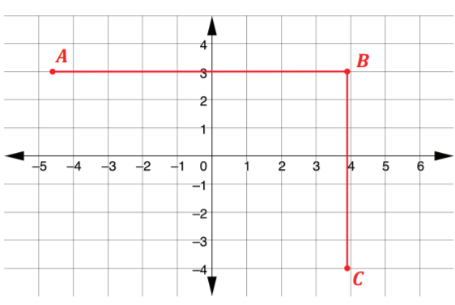

4.6.6 Your Turn!
Three vertices of a rectangle are at points 𝐴 $(−4\frac{3}{5},3)$, 𝐵 $(−3\frac{9}{10},3)$, and 𝐶 $\left(3\frac{9}{10},−4\right).$ Each gridline represents 1 centimeter.
a. What are the coordinates of the fourth vertex?
b. What is the area of the rectangle?
volume 1, pg. 169

Slide 19
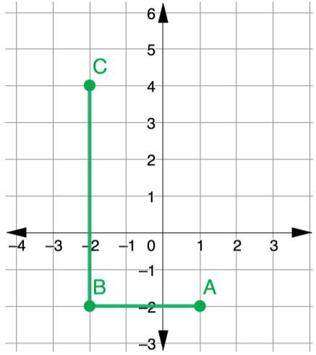
2. Jada needs to cut out a piece of fabric in the shape of a rectangle. She laid out the fabric on a cutting board, whose scale is represented in feet (ft). Jada placed two edges of the fabric at points 𝐴 and 𝐵. She wants the length of the fabric to be as long as the distance from point 𝐵 to point 𝐶.
a. Determine the coordinates of the fourth corner of the fabric.
b. Find the area of the piece of fabric.
volume 1, pg. 170

Slide 20

Wrap-Up
volume 1, pg. 170

Slide 21
4.6.7 Wrap-Up: Reflection
Complete the following statements.
a. Today I am still unsure about …
b. To fill this gap, I intend to …
volume 1, pg. 170

